Slide 1
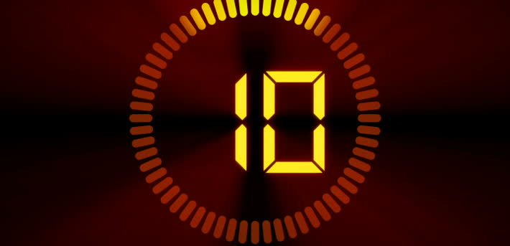
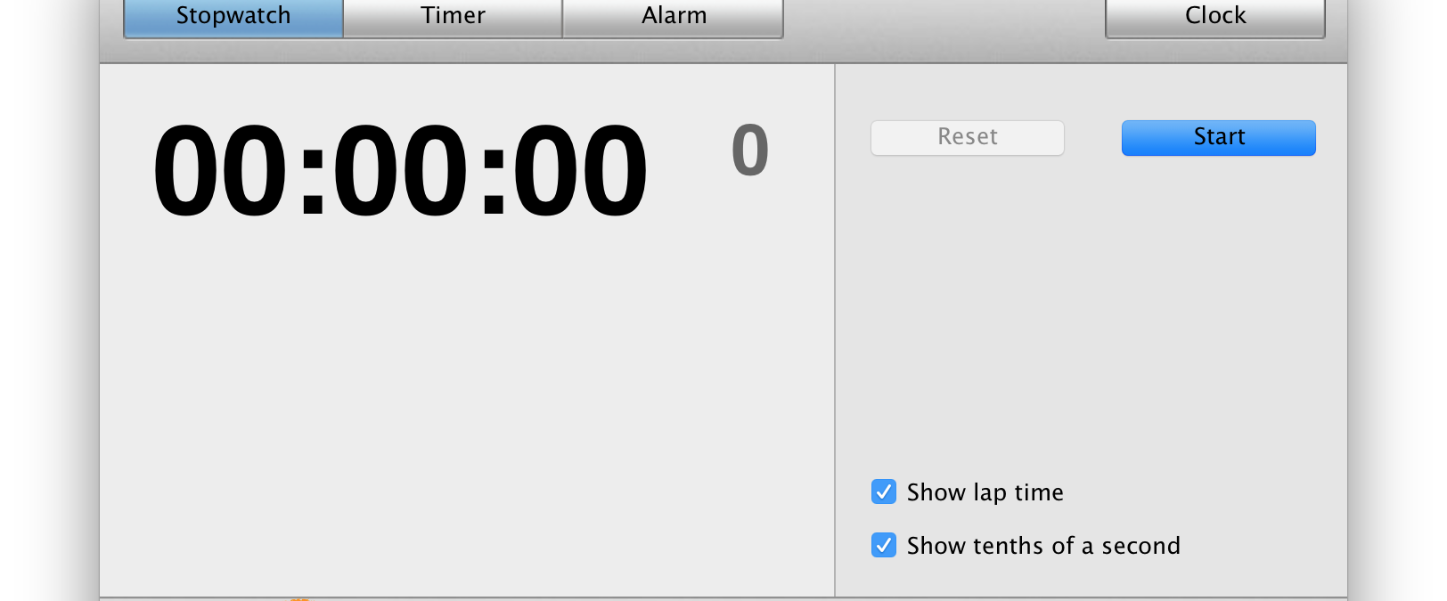
ULTIMATE COUNTDOWN
Ultimate Countdown is a timer that count down seconds and minutes.
This Photo by Unknown Author is licensed under CC BY-SA

